Slide 1
Constructing triangles
Task A: Constructing a scalene triangle
You will need a blank piece of A4 paper to draw all the answers to Task A. They will not fit on this sheet.
1) Construct this triangle accurately.
11 cm
6 cm
7 cm
2) Construct the triangle with edge lengths 6 cm, 8 cm and 10 cm.
3) Construct triangle ABC, where AB = 12 cm, BC = 13 cm and AC = 50 mm.
4) Construct the scalene triangle that has an edge of 6 cm, an edge of 7 cm and a perimeter of 23 cm.
5) Construct a scalene triangle with a perimeter of 180 mm.

Slide 2
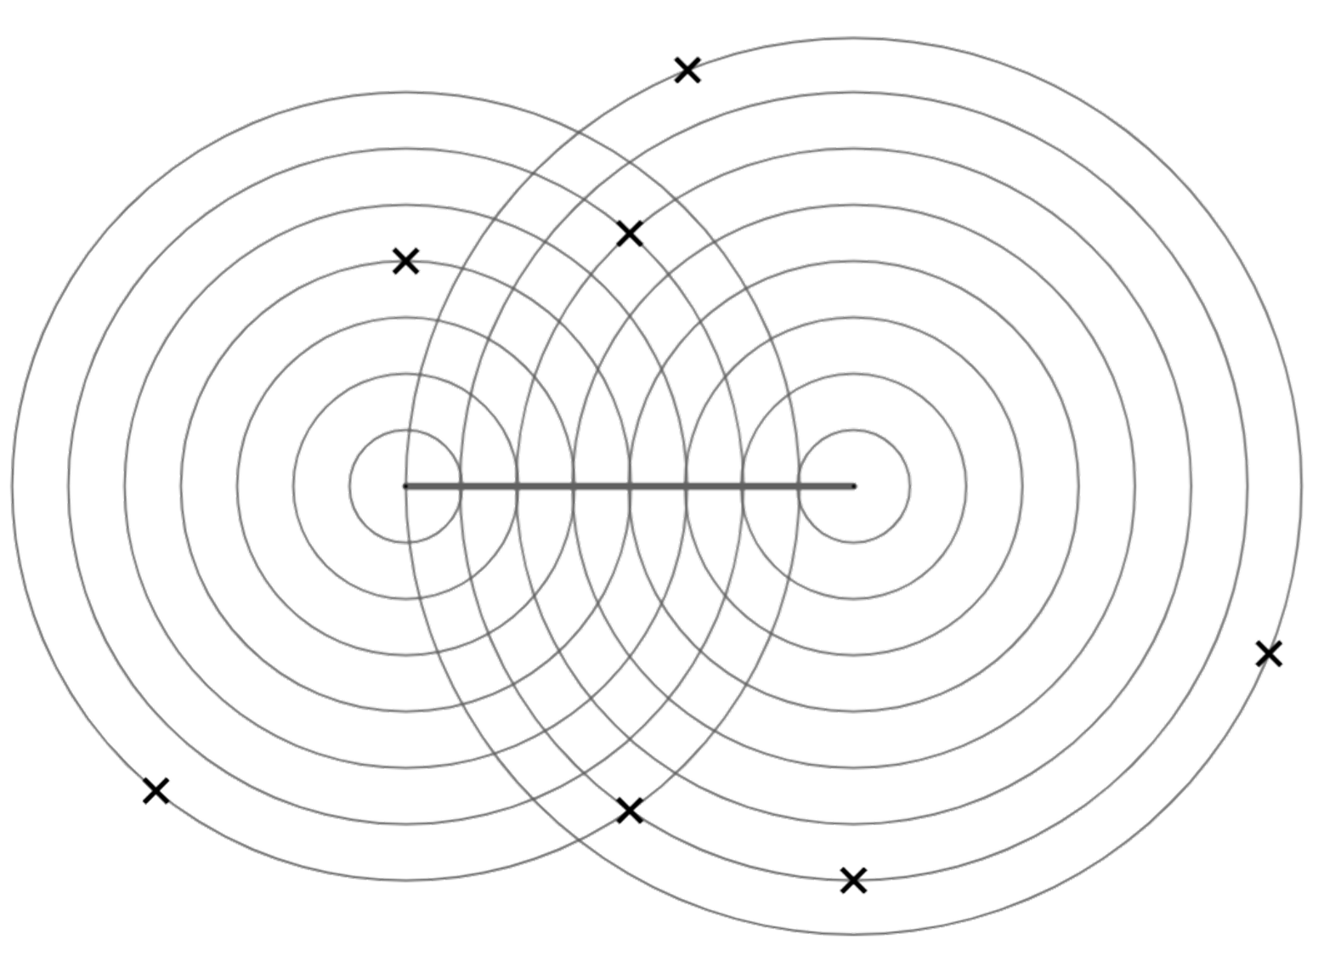

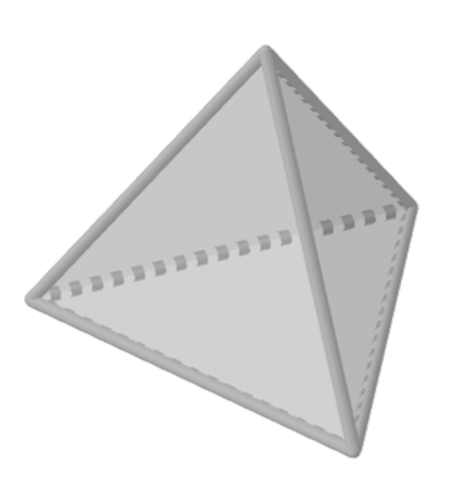
Constructing triangles
Task B: Constructing triangles with equal edges
1) XY is an edge of a triangle. Which of the points A to G when joined to XY would create:
C
a) an isosceles triangle
A
B
b) a right-angled triangle
X
Y
D
c) a right-angled isosceles triangle
G
F
E
2) Construct an equilateral triangle, using the line as one of the edges.
3) Construct an isosceles triangle where the equal edges are 9 units and the base edge is 7 units. Use this scale.
4) A tetrahedron is a 3D shape with four equilateral triangular faces. Construct the net of a tetrahedron. Draw this on a separate sheet of paper.
Mathematics in Education and Industry.
v2.3

